Slide 1
Data Cleaning and Transformation
Jose Luis Ambite
University of Southern California
[Based on slides by Mayank Kerijwal, Bo Wu, Craig Knoblock, Pedro Szekely, Joe Hellerstein]

Slide 2
Outline
Introduction
OpenRefine
Data Wrangler
FlashFill

Slide 3
Problem
Dirty Data
Not-Missing
Missing Data
Wrong Data
Not wrong, but unusable
Notes:
Data is not in the expected format

Slide 4
Why Data Cleaning and Transformation?
Data in the real world is dirty
incomplete: lacking attribute values, lacking certain attributes of interest, or containing only aggregate data
e.g., occupation=“”
noisy: containing errors or outliers (spelling, phonetic and typing errors, word transpositions, multiple values in a single free-form field)
e.g., Salary=“-10”
inconsistent: containing discrepancies in codes or names (synonyms and nicknames, prefix and suffix variations, abbreviations, truncation and initials)
e.g., Age=“42” Birthday=“03/07/1997”
e.g., Was rating “1,2,3”, now rating “A, B, C”
e.g., discrepancy between duplicate records
[Slide by Helena Galhardas]

Slide 5
Why Is Data Dirty?
Incomplete data comes from:
non available data value when collected
different criteria between the time when the data was collected and when it is analyzed.
human/hardware/software problems
Noisy data comes from:
data collection: faulty instruments
data entry: human or computer errors
data transmission
Inconsistent (and redundant) data comes from:
Different data sources, non uniform naming conventions/codes
Functional dependency and/or referential integrity violation
[Slide by Helena Galhardas]

Slide 6
Why is Data Quality Important?
Activity of converting source data into target data without errors, duplicates, and inconsistencies, i.e.,
Cleaning and Transforming to get…
High-quality data!
No quality data, no quality decisions!
Quality decisions must be based on good quality data (e.g., duplicate or missing data may cause incorrect or even misleading statistics)
[Slide by Helena Galhardas]
Notes:
Exemplo: se existirem duplicados ou erros, a corespondência enviada para casa pode levar a erros e,
Consequentemente a decisões não correctas. O problema pode estar nos dados utilizados para enviar a correspondência.

Slide 7
Solutions
Prevent dirty data from getting into the system
Enforce source integrity constraints
Not allow “null” for a field
Only allow numbers
…
Clean data
Manually clean the data
Write scripts

Slide 8
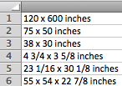
Challenges
120 x 600
70 x 50
38 x 30
…
55 x 54 x 22 7/8
Desired Data is
Task Dependent
120 | 160
70 | 50
38 | 30
…
55 | 54 | 22 7/8

Slide 9
Data Cleaning Workflow
Clean
Clean
Data
Data
Verify
Notes:
Ask whether they would use divide and conquer strategy ?

Slide 10
Data Transformation Operations
One to one mapping
One to many/ many to one mapping
Filter
Common functions: sum, min, max, avg …
Look up and join

Slide 11
One Row to One Row Mappings
Drop Column
Copy Column
Add Column
Constant value, random number, serial number
Merge Columns with Glue
Value update
Split Column
by position
by regular expression (first match)
Filter
by arithmetic expression
by regular expression
Name
George
Paul
Ann
Name
<Name>George</Name>
<Name>Paul</Name>
<Name>Ann</Name>
(.*) to <Name>\1</Name>

Slide 12
Example
Stewart,Bob
Format
Bob Stewart
Anna
Davis
'(.*), (.*)' to '\2 \1'
Anna
Davis
Dole,Jerry
Jerry Dole
Joan
Marsh
Joan
Marsh
Split at ' '
Bob
Stewart
2 Merges
Bob
Stewart
Anna
Davis
Anna
Davis
Jerry
Dole
Jerry
Dole
Joan
Marsh
Joan
Marsh
Vijayshankar Raman, Joseph M. Hellerstein

Slide 13
One Row To Many Rows: Fold
A | B | C | D | E | F
a1 | b1 | c1 | d1 | e1 | f1
fold(D, E, F)
A | B | C
a1 | b1 | c1 | d1
a1 | b1 | c1 | e1
a1 | b1 | c1 | f1

Slide 14
One Row To Many Rows: Fold
Name
Math
Bio
2 Formats
Name
Ann
43
78
(demotes)
Ann
Math:43
Bio:78
Bob
96
54
Bob
Math:96
Bio:54
Fold
Name
Name
Ann
Math
43
Split
Ann
Math:43
Ann
Bio
78
Ann
Bio:78
Bob
Math
96
Bob
Math:96
Bob
Bio
54
Bob
Bio:54
Vijayshankar Raman, Joseph M. Hellerstein

Slide 15
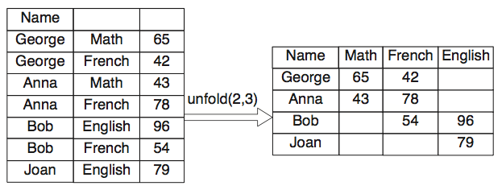
Many Rows to One Row: Unfold
unfold(col_1, col_2)

Slide 16

OpenRefine
Powerful tool for data cleansing
Helps in working with raw data, cleaning it up, transforming from one format to other, encompassing it with web services and linking it to databases.
Easy to use and has a web interface
Freely available and works well with any browser.
Desktop application and it runs a small web server on your system and we need to point our browser to the server to use refine.

Slide 17
OpenRefine (formerly Google Refine)
Website: http://openrefine.org/
Documentation: https://github.com/OpenRefine/OpenRefine/wiki
Videos
Explore Data
https://www.youtube.com/watch?v=B70J_H_zAWM&feature=youtu.be
Clean and Transform Data
https://www.youtube.com/watch?v=vtTUKLE_SWE
Reconcile and Match Data
https://www.youtube.com/watch?v=5tsyz3ibYzk

Slide 18
Importing Data
Google Refine supports TSV, CSV, Excel (.xls and .xlsx), JSON, XML, and Google data document formats.
Once imported the data is in Google Refine’s own data format.
We have used TSV data on Disasters worldwide from 1900-2008 available from http://www.infochimps.com/datasets/disasters-worldwide-from-1900-2008 for the tutorial.

Slide 19
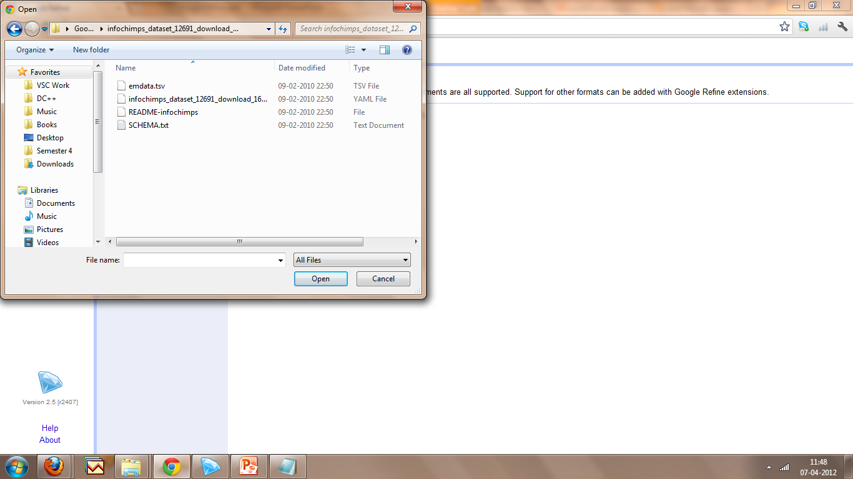
Importing Data

Slide 20
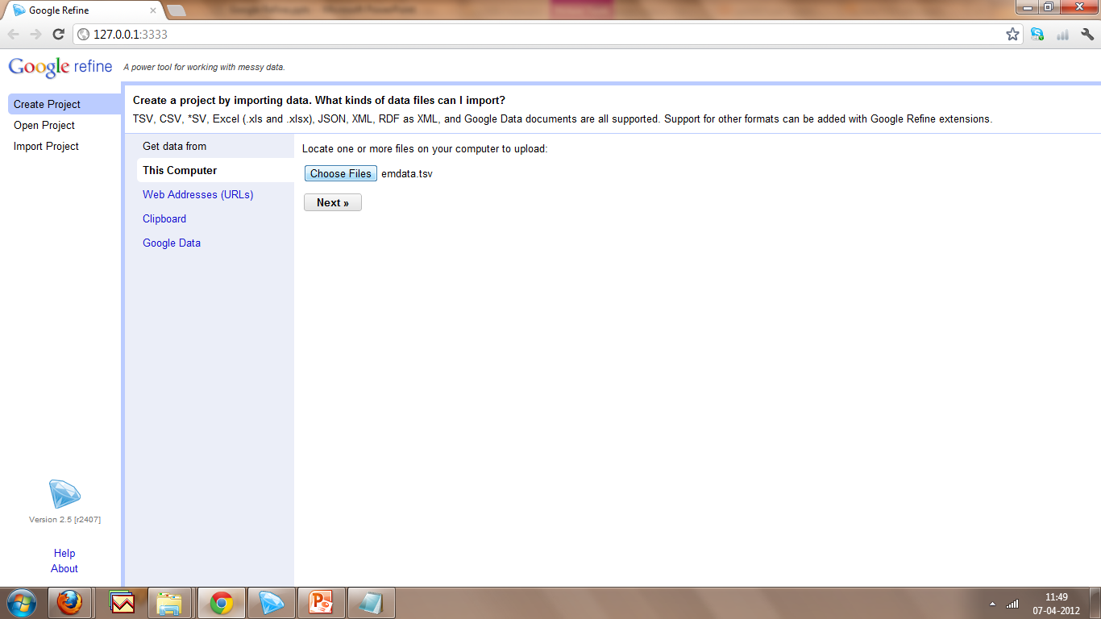
Importing Data

Slide 21
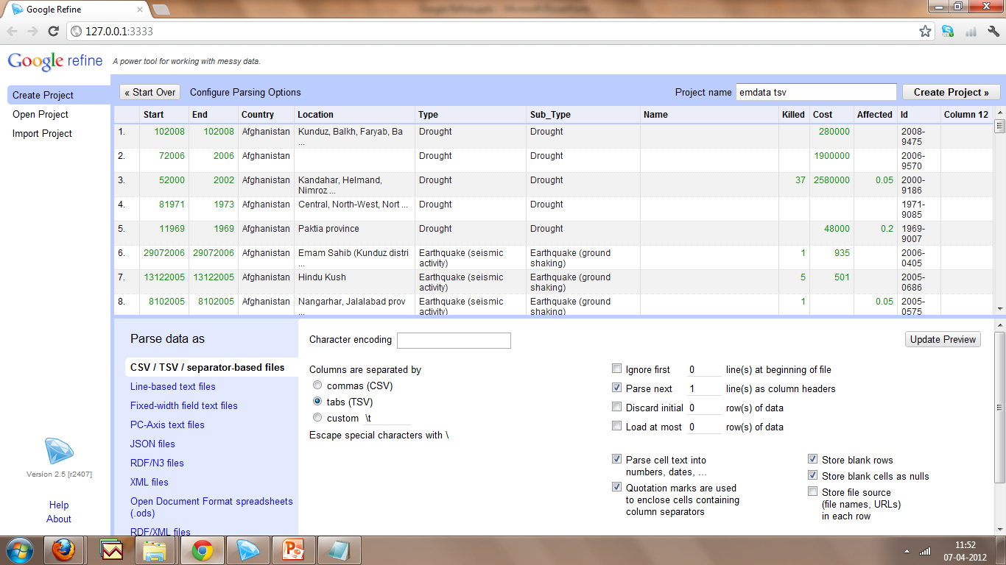
Creating Project
Data Uploaded

Slide 22
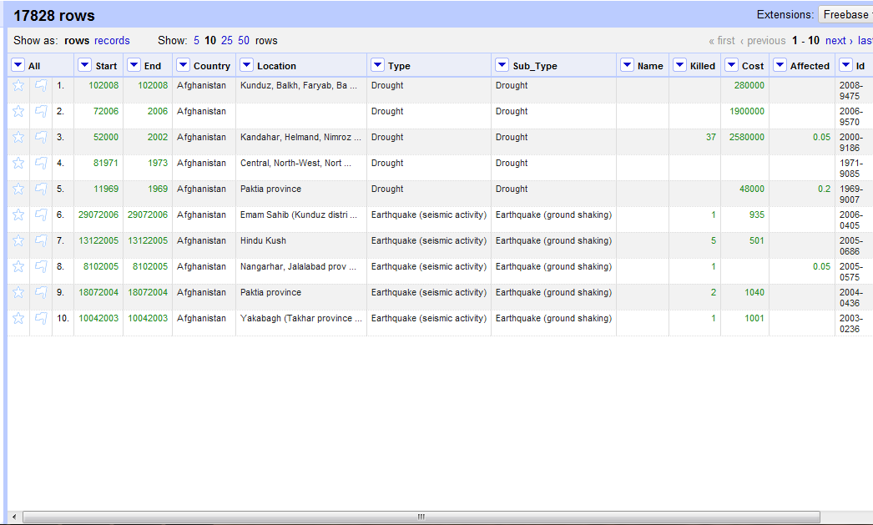
Creating Project
Project Created

Slide 23
Faceting
Faceting is about seeing the big picture and filtering based on rows to work on data you want to change in bulk.
We can create a facet for a column to get the details about that column and then we can filter to a subset of rows with a constraint.
We can perform text facet, Numeric facet, timeline facet and scatterplot facet. Also various customized facets can be designed.

Slide 24
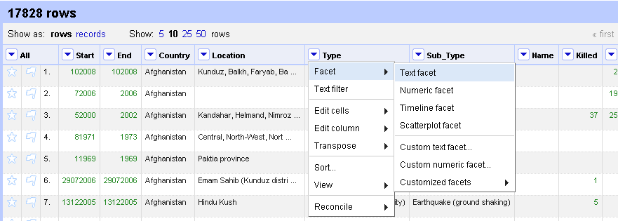
Faceting

Slide 25
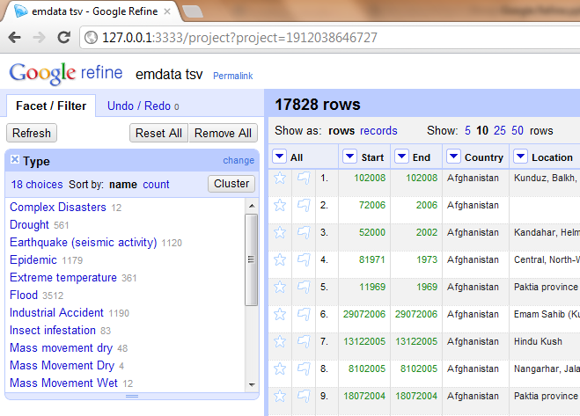
Faceting
The Column Type has 18 unique options

Slide 26
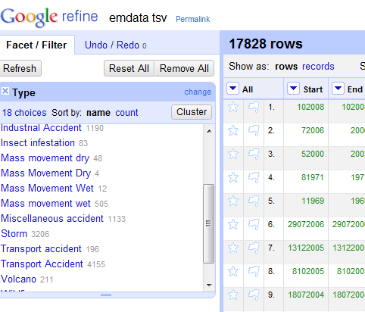
Removing Redundancy
Even though they are of same type, shows as different options due to case

Slide 27
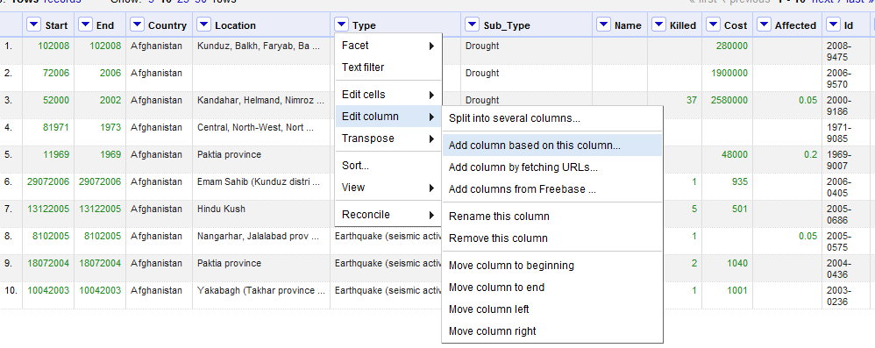
Removing Redundancy

Slide 28
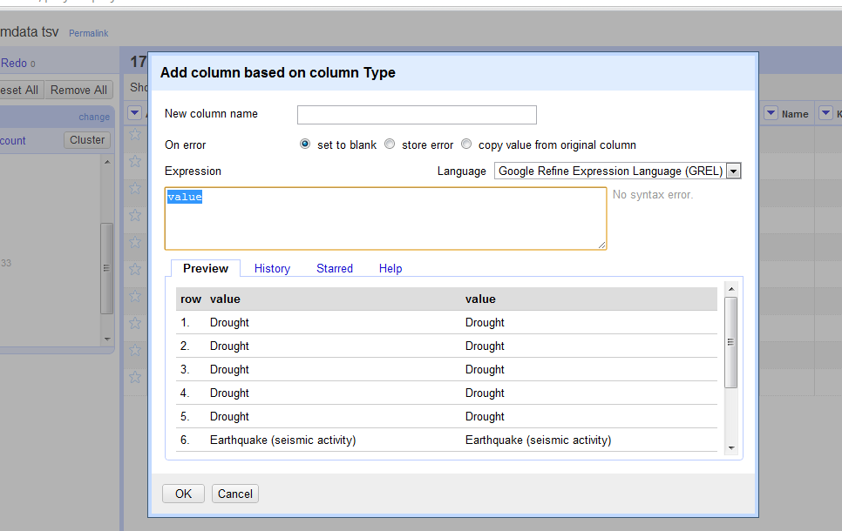
Removing Redundancy

Slide 29
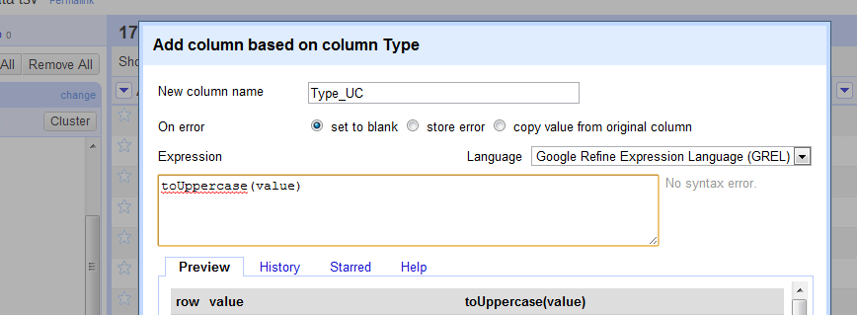
Removing Redundancy

Slide 30
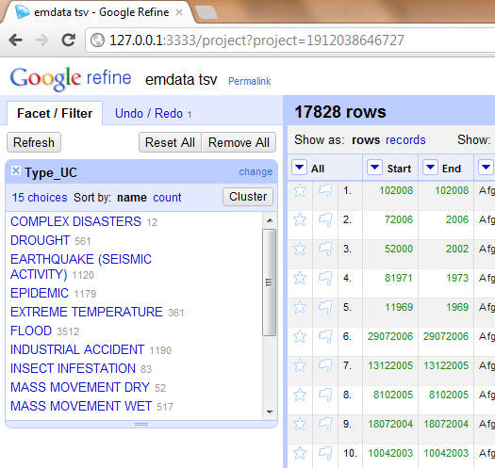
Removing Redundancy
Reduced to 15 unique options

Slide 31
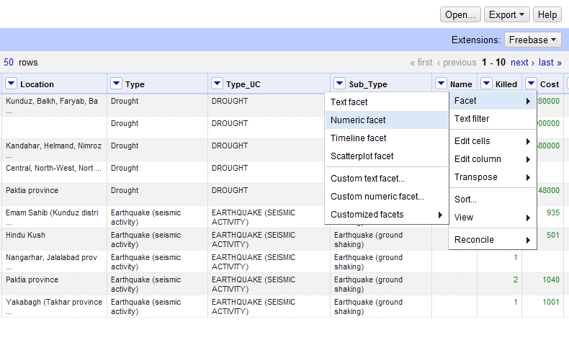
Numeric Faceting

Slide 32
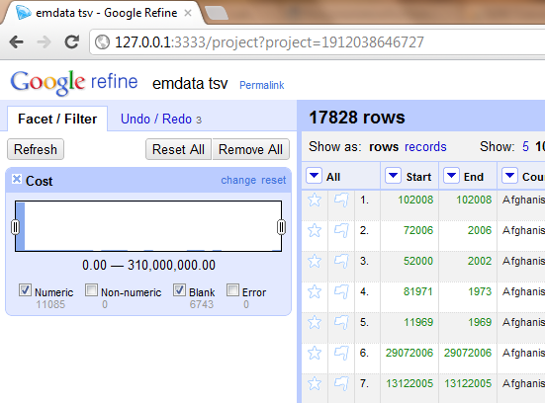
Numeric Faceting
Highly clustered towards low values

Slide 33
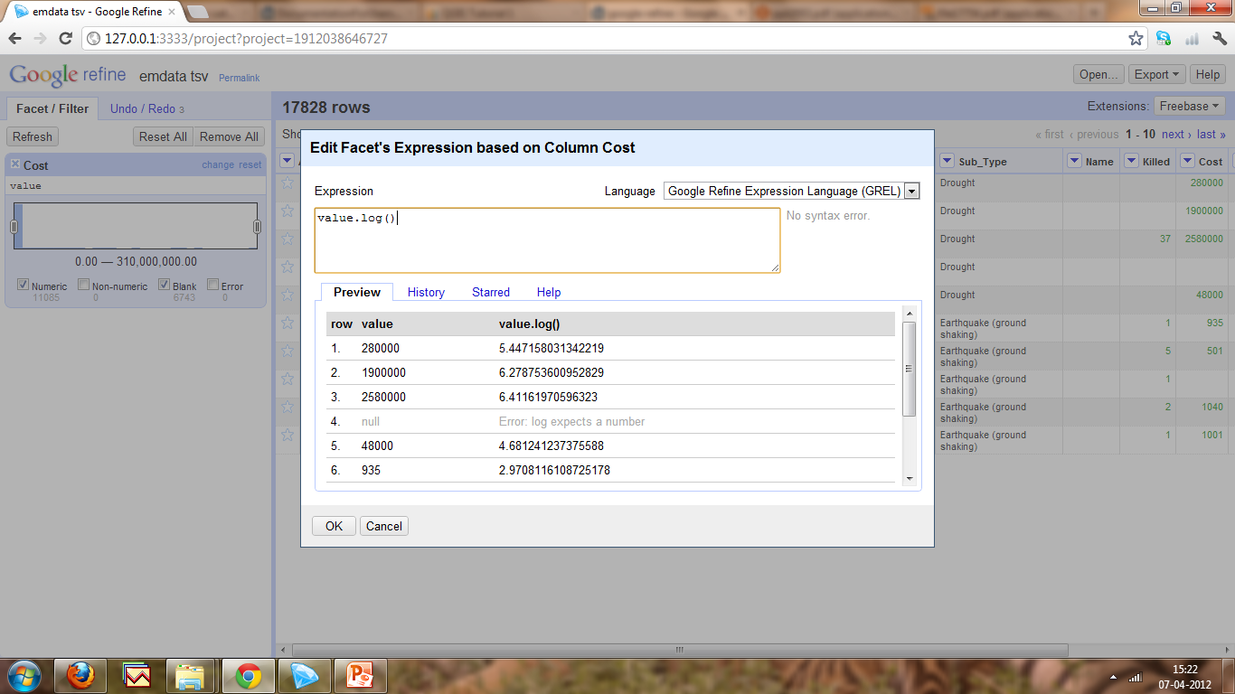
Numeric Faceting
Use value.log() function

Slide 34
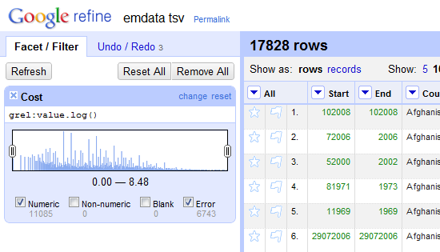
Numeric Faceting

Slide 35
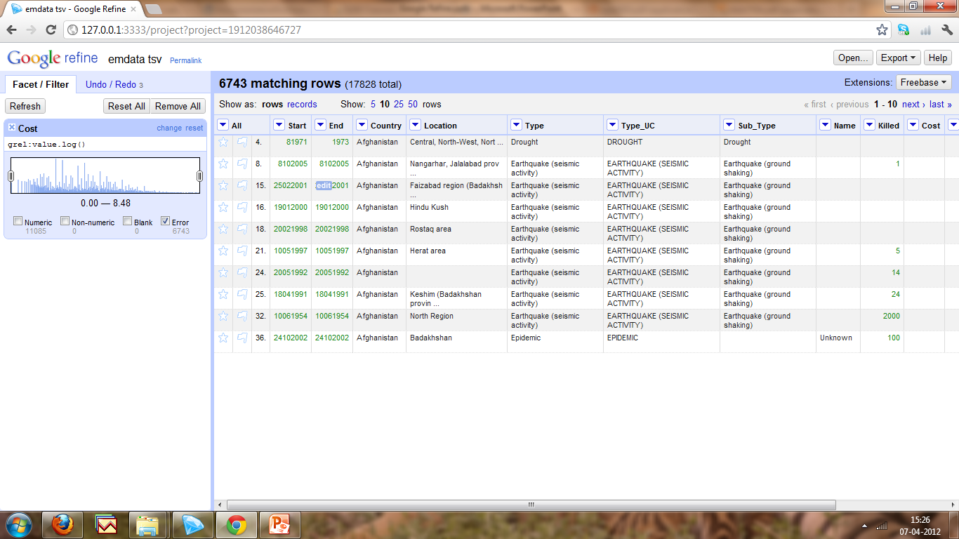
Numeric Faceting
Cost column is blank and has no value

Slide 36
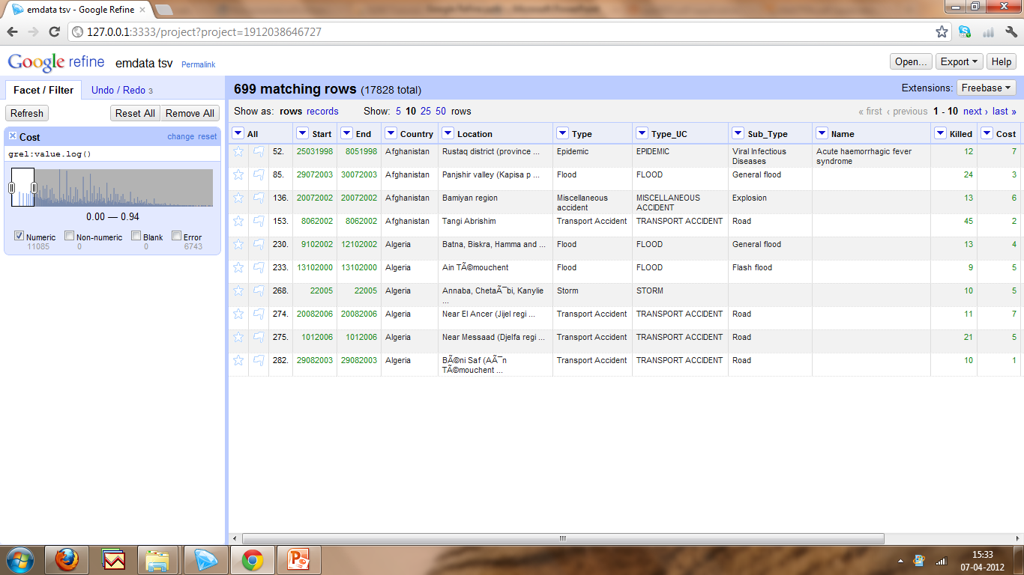
Numeric Faceting
Calamities with low cost

Slide 37
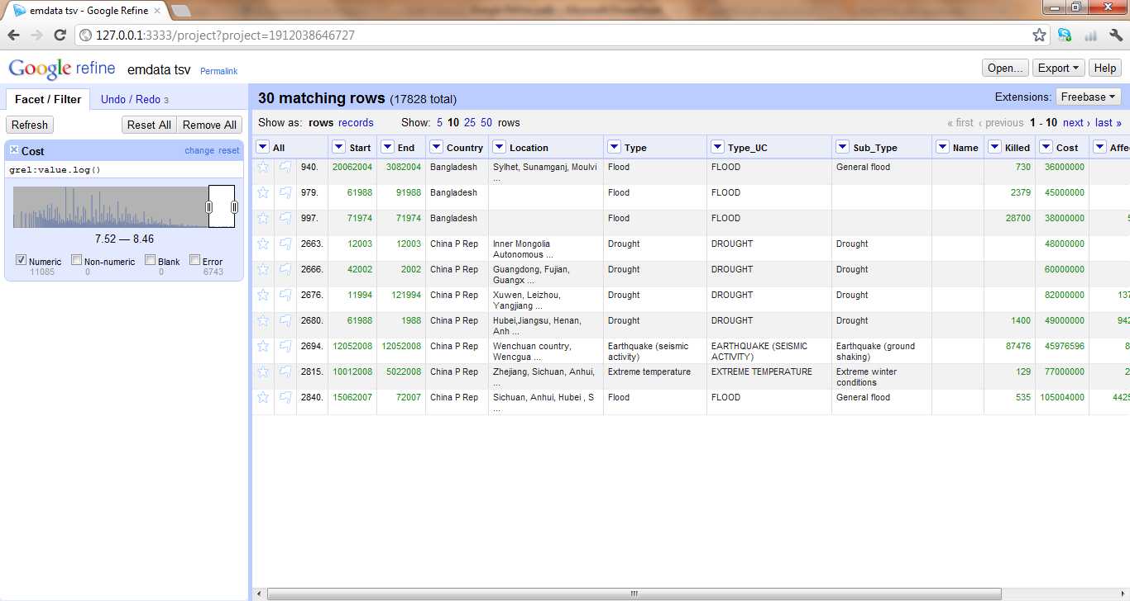
Numeric Faceting
Calamities with high cost

Slide 38
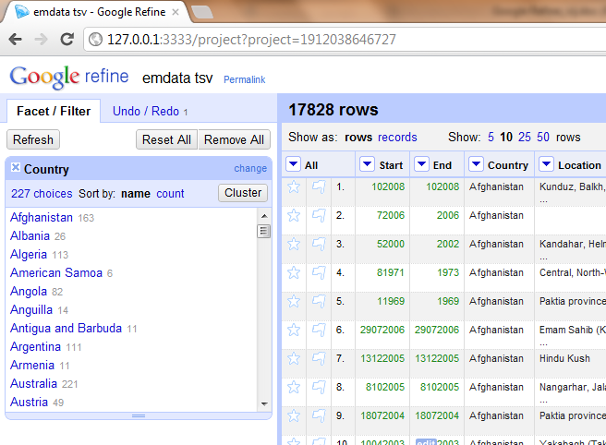
Clustering
Clustering is used to merge choices which look similar.

Slide 39
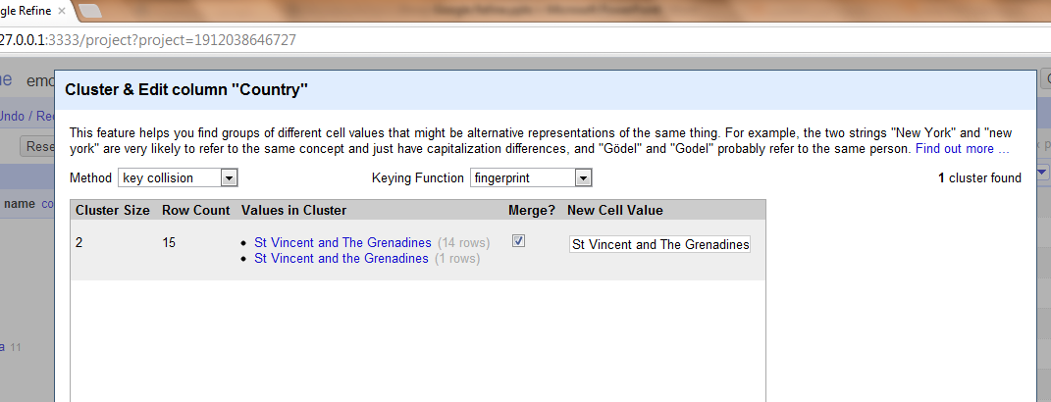
Clustering

Slide 40
OpenRefine Fingerprint
Fast, simple method to compare/cluster string
Default Method: works relatively well in a variety of contexts, Least likely to produce false positives
Method (order of operations is significant):
remove leading and trailing whitespace
change all characters to their lowercase representation
remove all punctuation and control characters
normalize extended western characters to ASCII representation
for example "gödel" → "godel"
split the string into whitespace-separated tokens
sort the tokens and remove duplicates
join the tokens back together

Slide 41
Transformations
Splitting data in a single column into multiple columns e.g. splitting date into Month, day and year)
Standardizing a column’s data format without changing the values e.g. removing punctuation or standardizing a date format
Extracting a particular type of data from a longer text string e.g. finding ISBNs in a bibliographic citation
GREL (General Refine Expression Language) is the language used for writing Transformations
https://github.com/OpenRefine/OpenRefine/wiki/General-Refine-Expression-Language

Slide 42
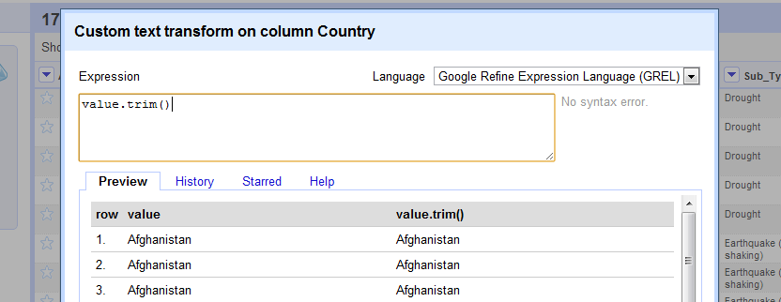
Using Expressions

Slide 43
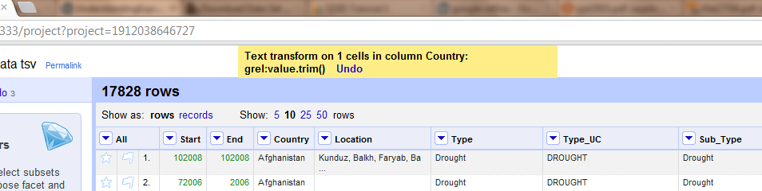
Using Expressions

Slide 44
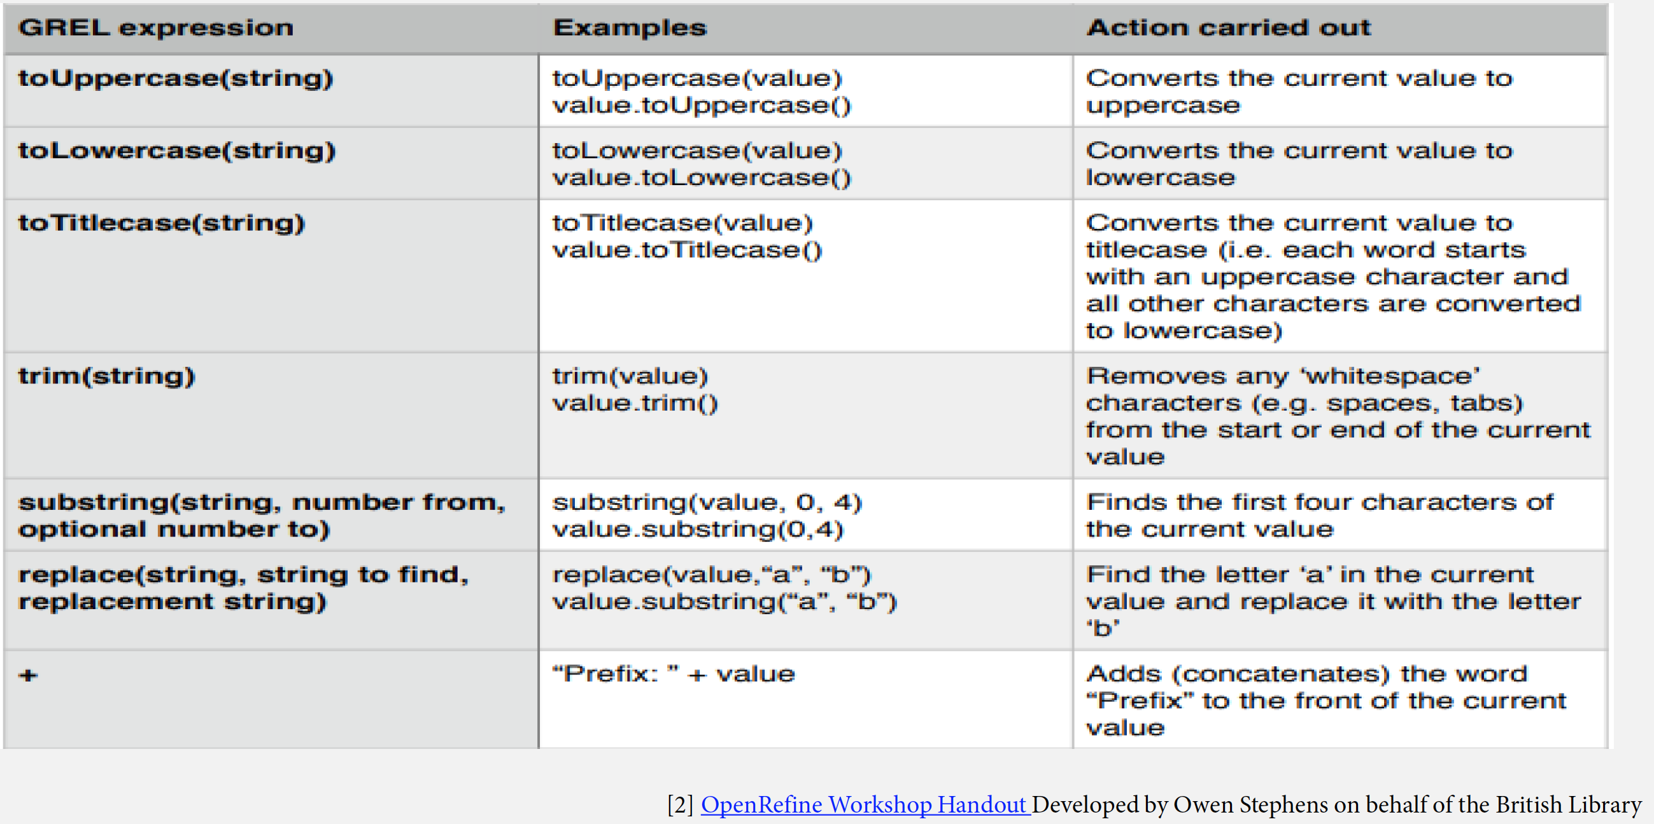
Common GREL Expressions

Slide 45
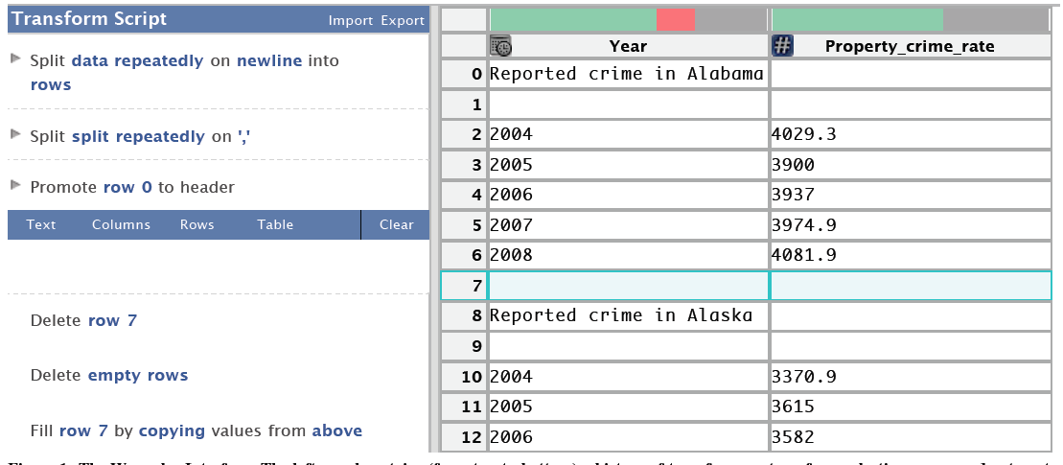

Data Wrangler
Interactive system for creating data transformations
Suggest transforms
Iteratively explore the space of applicable operation
Became a company:

Slide 46
Demonstration Videos
Data Wrangler
http://vimeo.com/19185801
Trifacta
Introduction to Trifacta for Data Preparation
https://www.youtube.com/watch?v=g_wk9ino9sI
Trifacta Demo: Data Preparation For Machine Learning
https://www.youtube.com/watch?time_continue=1&v=lB3B01BfSP4
Data Onboarding: Combining Disparate Data Into a Consistent View
https://www.youtube.com/watch?v=WO5MhQJljeQ

Slide 47
Inference Engine
Inference parameter sets based on users’ input
Row, type and text selection
Identify all compatible operations
Rank the operations

Slide 48
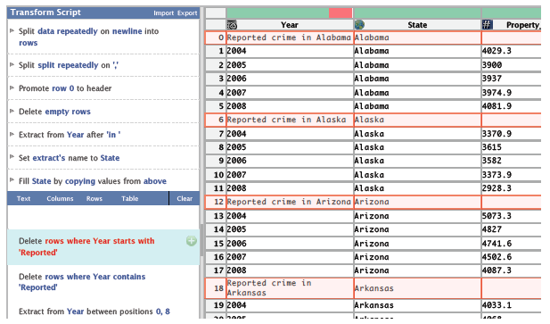
An Example

Slide 49
FlashFill in Excel
Transforming by entering input-output examples
https://www.youtube.com/watch?v=YPG8PAQQ894
https://www.youtube.com/watch?v=aMdnbMQImVg

Slide 51
An Iterative Approach to Synthesize Data Transformation Programs
Bo Wu and Craig Knoblock University of Southern California

Slide 52
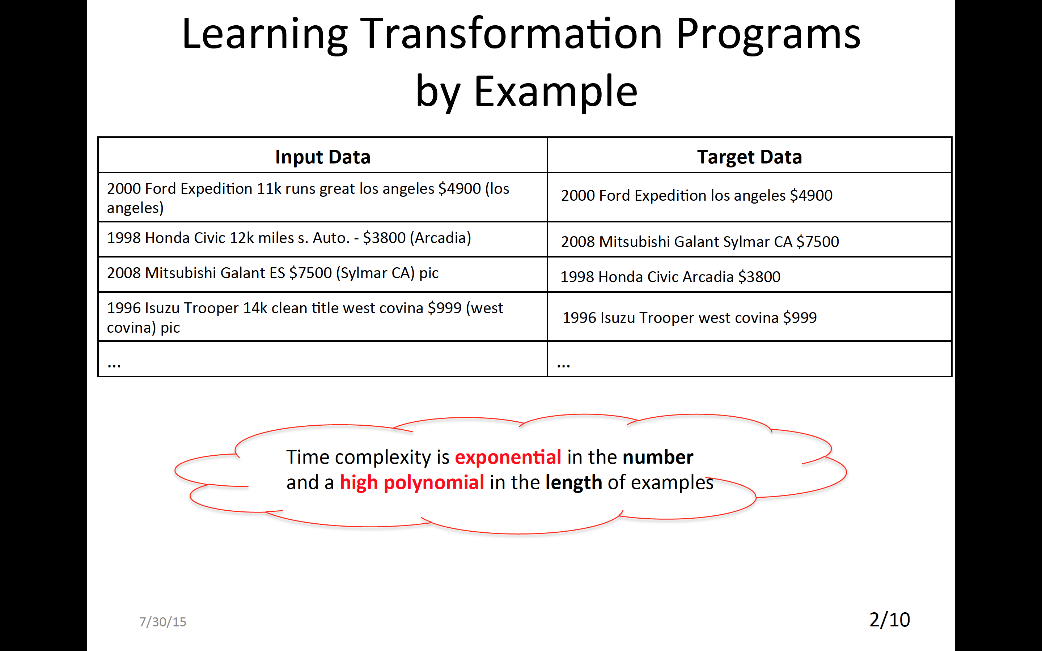

Slide 53
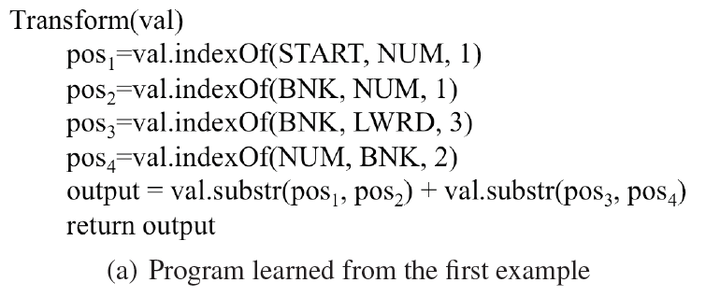

Slide 54
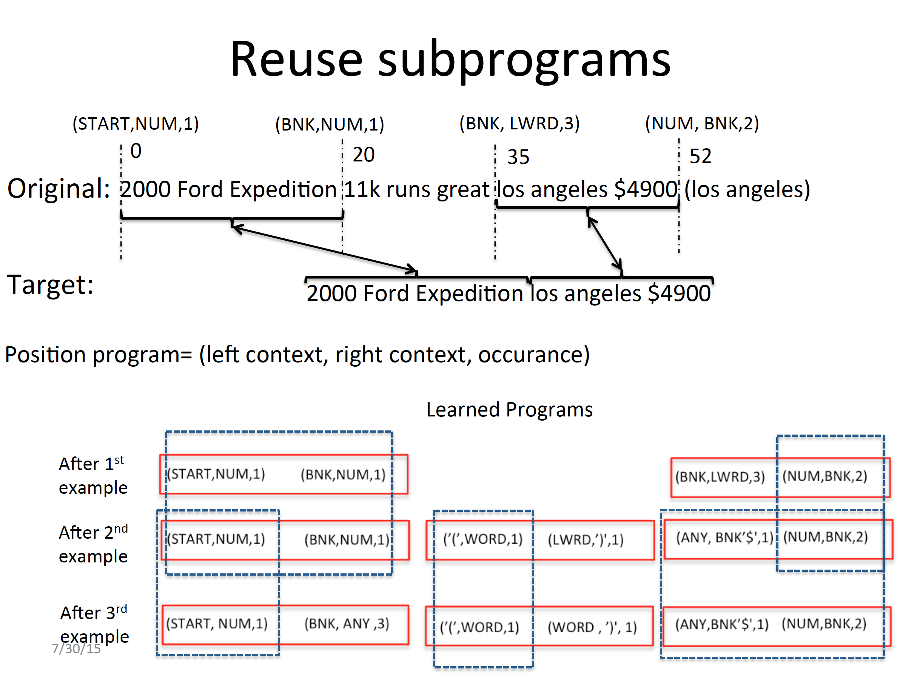

Slide 55
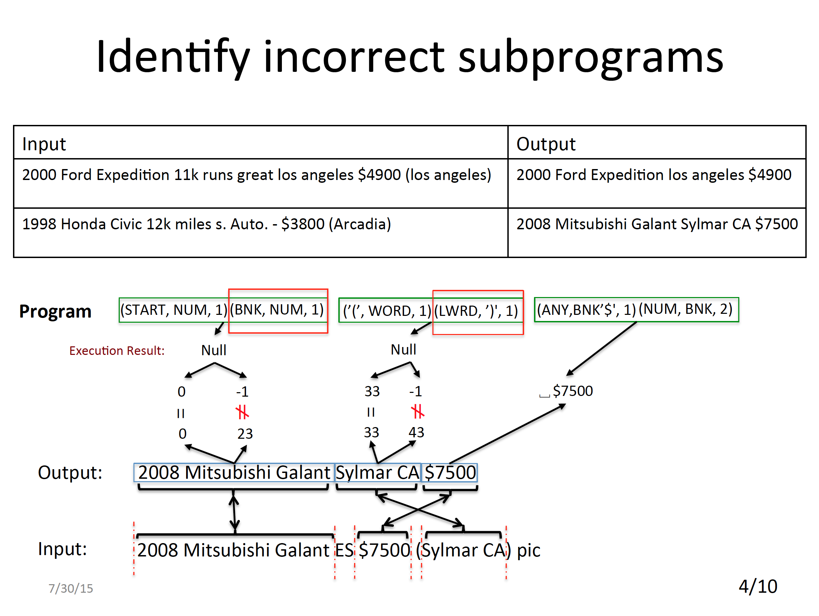

Slide 56
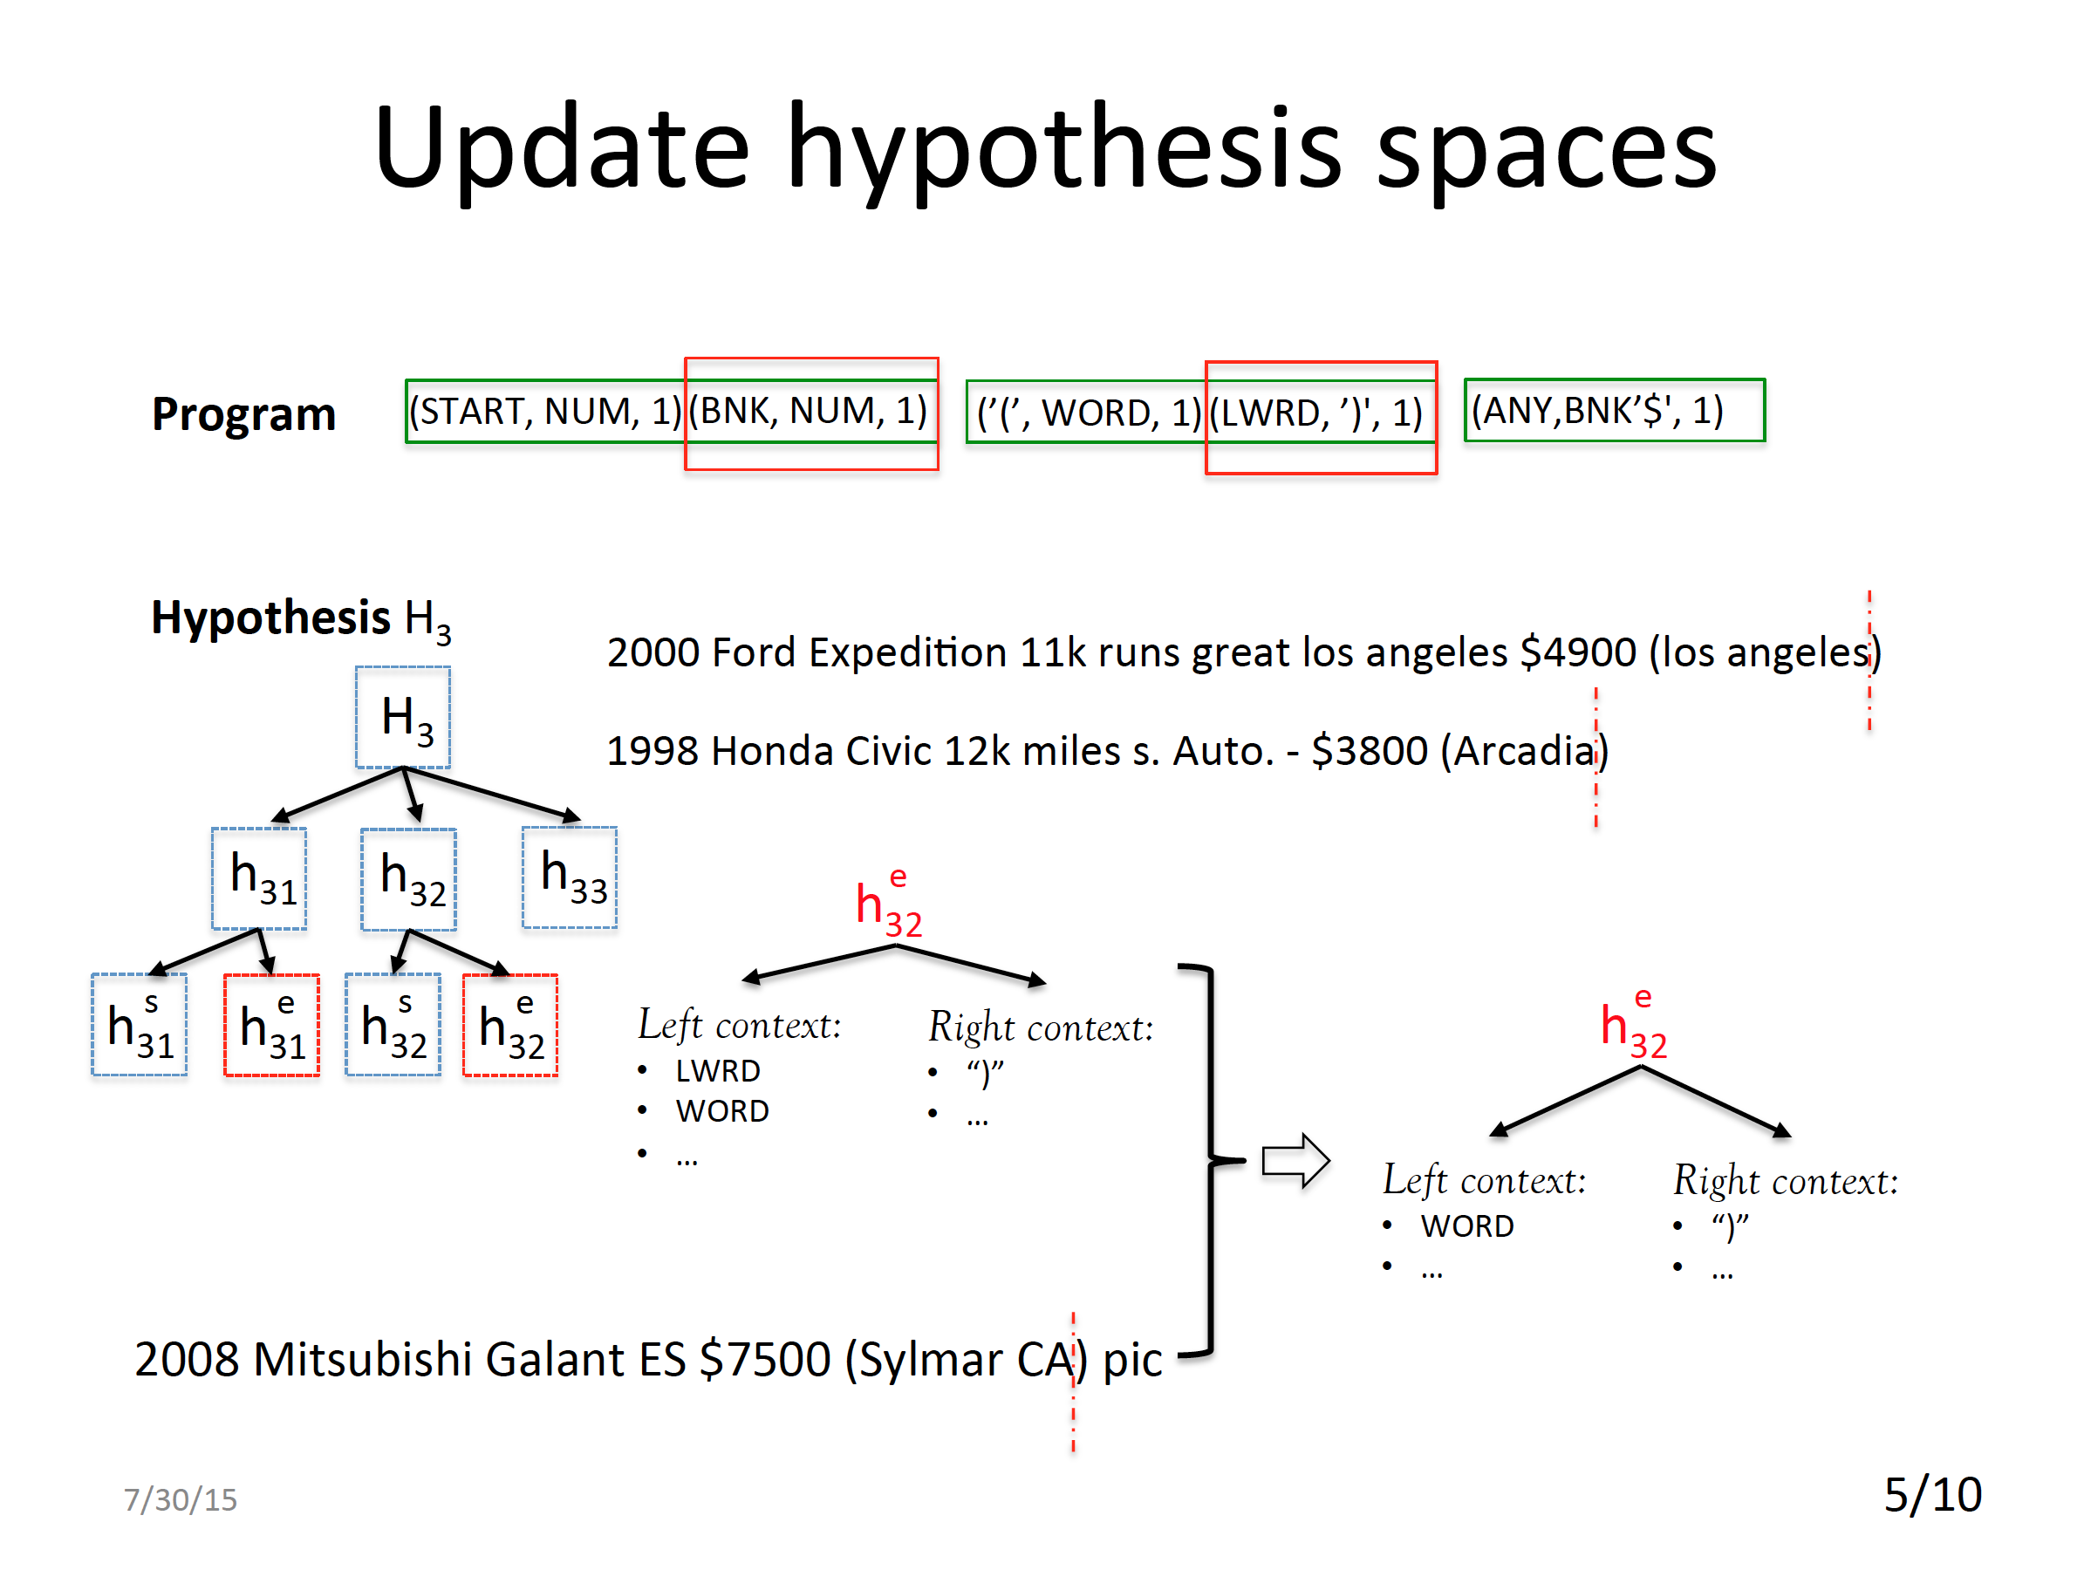

Slide 57
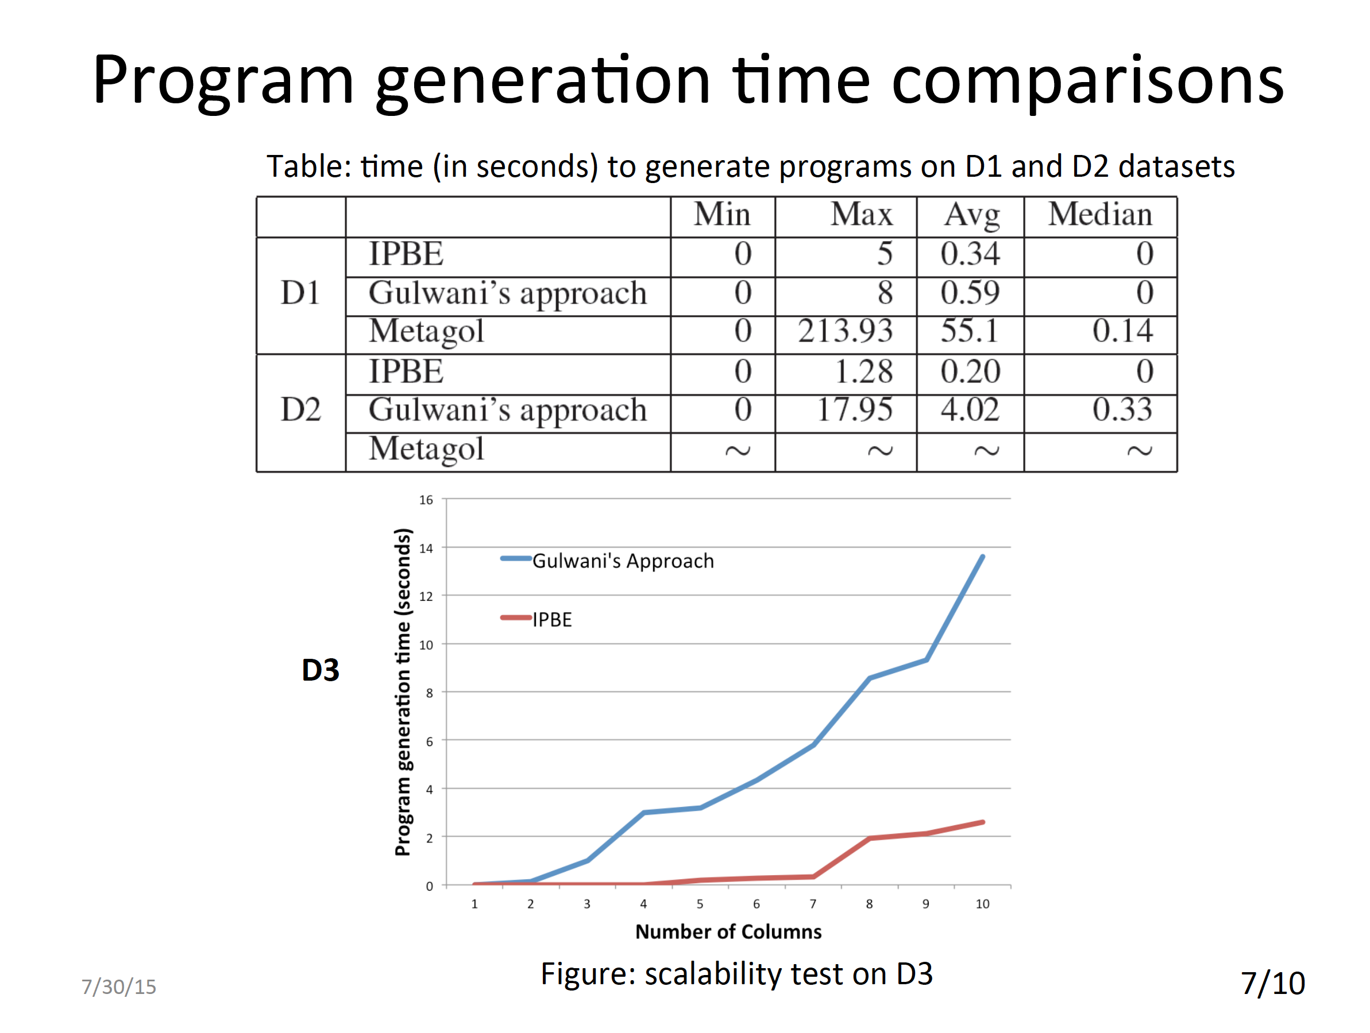

Slide 58
A Data Table
Accession | Credit | Dimensions | Medium | Name
01.2 | Gift of the artist | 5.25 in HIGH x 9.375 in WIDE | Oil on canvas | John Mix Stanley
05.411 | Gift of James L. Edison | 20 in HIGH x 24 in WIDE | Oil on canvas | Mortimer L. Smith
06.1 | Gift of the artist | Image: 20.5 in. HIGH x 17.5 in. WIDE | Oil on canvas | Theodore Scott Dabo
06.2 | Gift of the artist | 9.75 in|16 in HIGH x 13.75 in|19.5 in WIDE | Oil on canvas | Leon Dabo
…
09.8 | Gift of the artist | 12 in|14 in HIGH x 16 in|18 in WIDE | Oil on canvas | Gari Melchers
Notes:
Data user constantly need to work spreadsheet.
1st introduce the scenario various format
2nd how people do it in traditional way
3rd, programming-by-example

Slide 59
Programming by Example
 | Raw Value | Target Value
R1 | 5.25 in HIGH x 9.375 in WIDE
R2 | 20 in HIGH x 24 in WIDE
R3 | Image: 20.5 in. HIGH x 17.5 in. WIDE
R4 | 9.75 in|16 in HIGH x 13.75 in|19.5 in WIDE
R5 | 12 in|14 in HIGH x 16 in|18 in WIDE
9.375
24
17.5
null
null
24
17.5
19.5
18
24
17.5
19.5
null
. . .

Slide 60
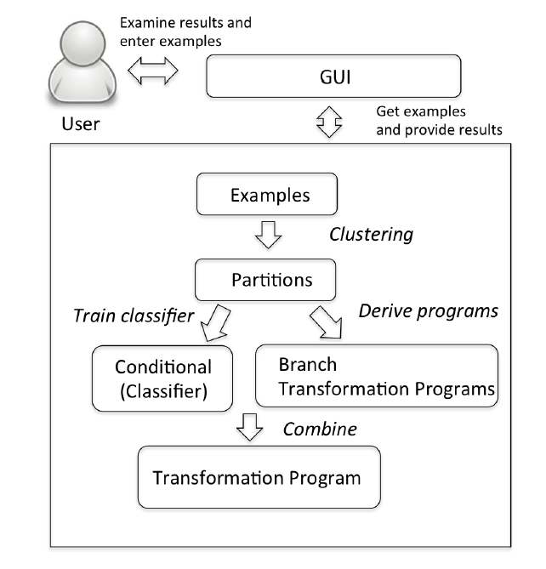
System Architecture
Notes:
The previous approach
Two problems
Low efficiency
Verifying whether two partitions are compatible with each other
Few examples

Slide 61
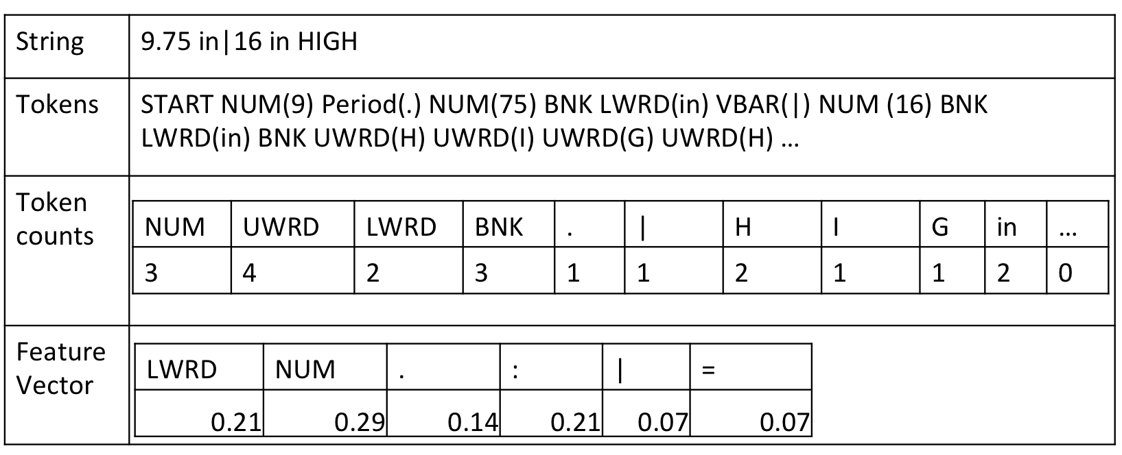
Data Preprocessing

Slide 62
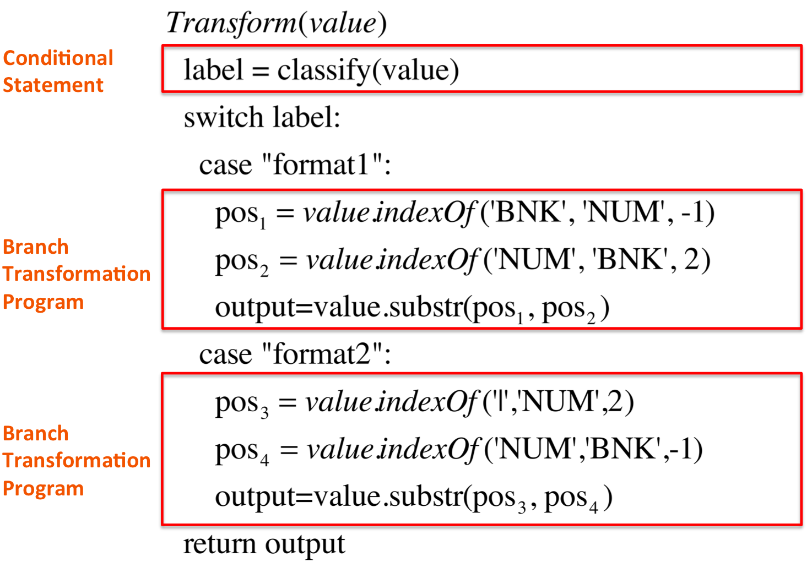
Transformation Program
BNK: blankspace
NUM[0-9]+: 98
UWRD[A-Z]: I
LWRD[a-z]: mage
WORD[a-zA-Z]
START:
END:
Example: 9.75 in|16 in HIGH x 13.75 in|19.5 in WIDE ➔ 19.5
Notes:
Explain the tokens first
examples for the tokens.

Slide 63
Creating Hypothesis Spaces
Segmenting the Outputs ( n! traces)
Create Hypothesis Space
I:
5.25 in HIGH x 9.375 in WIDE
1st
O:
9.375
Constant
2nd
9.375
3nd
9.375
O(N²) unique substrings
…
Substring
1.subString(starPosition, endPosition)
2. Constant String
StartPostion
1. 15
2. (BNK, NUM, 1)
3. (BNK,9,-1)
4. (LWRD BNK, NUM ’.’,1)
…
Notes:
Segmentize of the outputs
Establish the mapping between the input and output for each particular example.
Missing Hypothesis/ generating program from the Hypothesis Space.

Slide 64
Generating Programs
Generate programs from Hypothesis Space
Generate and then verify
Select values for non-terminals based on a partial order
Number of the Segments
Length of the context
Token class or actual text

Slide 65
Learn Conditional Statement
Clustering:
Agglomerative Clustering
2. Compatibility Score
P1
P2
e4
e2
e1
e3
Notes:
Verifying the compatibility of partitions is expensive
Cs1 doesn’t decrease total compatibility among the examples.
Cs2 prefer the partitions with a larger overlapped area.

Slide 66
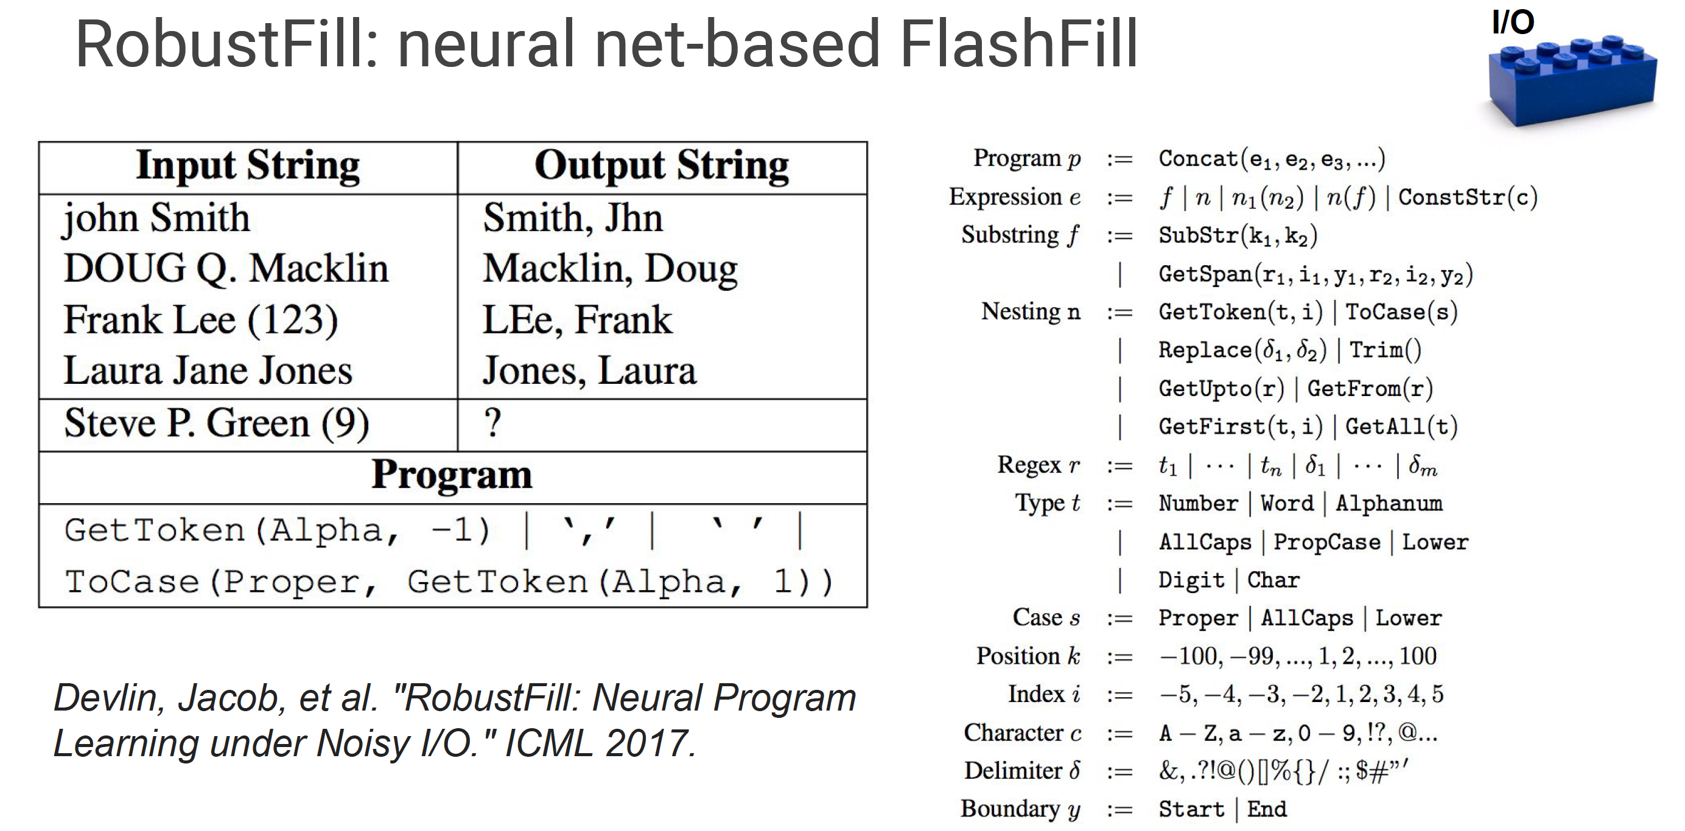
[Slide From Deep Learning: Practice and Trends, by Scott Reed, Nando de Freitas, Oriol Vinyals. NIPS 2017]

Slide 67
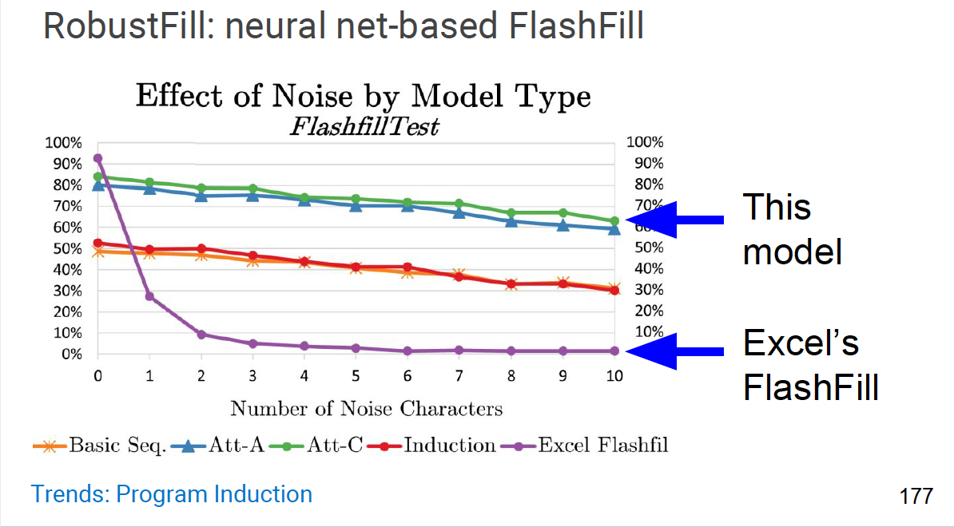
[Slide From Deep Learning: Practice and Trends, by Scott Reed, Nando de Freitas, Oriol Vinyals. NIPS 2017]

Slide 68
Handling Missing Data for Statistical Analysis
Commonly recommended ways of dealing with missing data:
Dropping observations that have missing values
Imputing the missing values based on other observations

Slide 69
Dropping missing values
Dropping missing values is sub-optimal because when you drop observations, you drop information.
The fact that the value was missing may be informative in itself.
Plus, in the real world, you often need to make predictions on new data even if some of the features are missing!
You can drop
vertically (a feature/column of the data) or
horizontally (some entry/row in your data)

Slide 70
Imputing missing values
Missing categorical data
Best is to simply label them as ’Missing’!
Essentially adding a new class for the feature: tell algorithm value was missing
Missing numeric data
Fill with the mean, median
Filling with a special value
Allowing an algorithm to estimate the values
Ex: Predict based on the other attributes

